Slide 1
De Bruijn meets DNA: Utilizing reverse complementarity to efficiently cover all k-mers, with application to protein binding microarrays
Yaron Orenstein
ACGT group meeting
August 8th, 2012

Slide 2
Outline
Introduction.
Our solution (for odd and even k, separately).
Results.
Open issues.
Conclusions.

Slide 3
INTRODUCTION

Slide 4
Gene expression regulation
Transcription is regulated mainly by transcription factors (TFs) - proteins that bind to DNA subsequences, called binding sites (BSs).
TFBSs are located mainly in the gene’s promoter – the DNA sequence upstream the gene’s transcription start site (TSS).
TFs can promote or repress transcription.
Other regulators: micro-RNAs (miRNAs).

Slide 5
Measuring TF binding
In vivo technologies:
ChIP-chip (Aparicio et al. 04).
ChIP-seq (Johnson et al. 07).
ChIP-exo (Ree and Pugh 11).
Harder to measure low-affinity binding.
DNA sequences are genomic.
Binding involves other factors.

Slide 6
Measuring TF binding – cont’d
In vitro technologies:
Protein binding microarrays (PBM) (Berger et al. 06).
Mechanically induced trapping of molecular interactions (MITOMI) (Fordyce et al. 10).
High-throughput SELEX (Ogawa and Biggin 12).
High-throughput sequencing (Nutiu et al. 11).
Can measure different affinities.
DNA sequences are pre-designed.
Binding is purely due to TF direct binding.

Slide 7
Designing DNA sequences
Random sequences:
High-throughput SELEX.
High-throughput sequencing.
Optimal coverage of k-mers:
PBM.
MITOMI.

Slide 8
Mathematical design of probe sequences
A paper by Mintseris and Eisen (BMC Bioinformatics 06):
Use of de Bruijn sequences.
Exploiting reverse complementary.
Philipikkas et al. (JCB 2007) focused on:
Using linear feedback shift registers.
Covering gapped k-mers.
Including words of length greater than k.

Slide 9
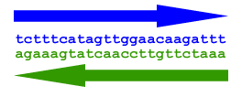
The question we study
What is the minimum length sequence that covers each k-mer or its reverse complement?
How can it be generated?
Motivation: DNA probe sequences are double stranded. Thus, covering a k-mer is equal to covering its reverse complement.

Slide 10
Was this problem already solved? (1)
“This means we are able to reduce the number of probes by a factor of k. Furthermore, we can turn the reverse complementarity of double-stranded DNA sequence to our advantage and gain another factor of 2 reduction in number of array probes[9, 11].”
The reference is to a technology that covers one k-mer in each probe.
(will get to that later…)

Slide 11
Another researcher working on this problem
Smanatha J. Riesenfeld worked on a similar problem: designing 15bp probes sequences that cover all 6-mers or their reverse complement.
According to her, the paper was submitted and is in review.
From her CV from 2010: “Optimal design of oligomer libraries using pseudo-de-Bruijn sets” was submitted (but no publication was found).

Slide 12
OUR SOLUTION

Slide 13
Definitions
Reverse complement de Bruijn sequence (RCdB) = a sequence that covers for each k-mer the k-mer or its reverse complement.
Optimal RCdB sequence = minimal length RCdB sequence. Denote n*(k) its length.
Possible constraint: cyclic sequence.

Slide 14
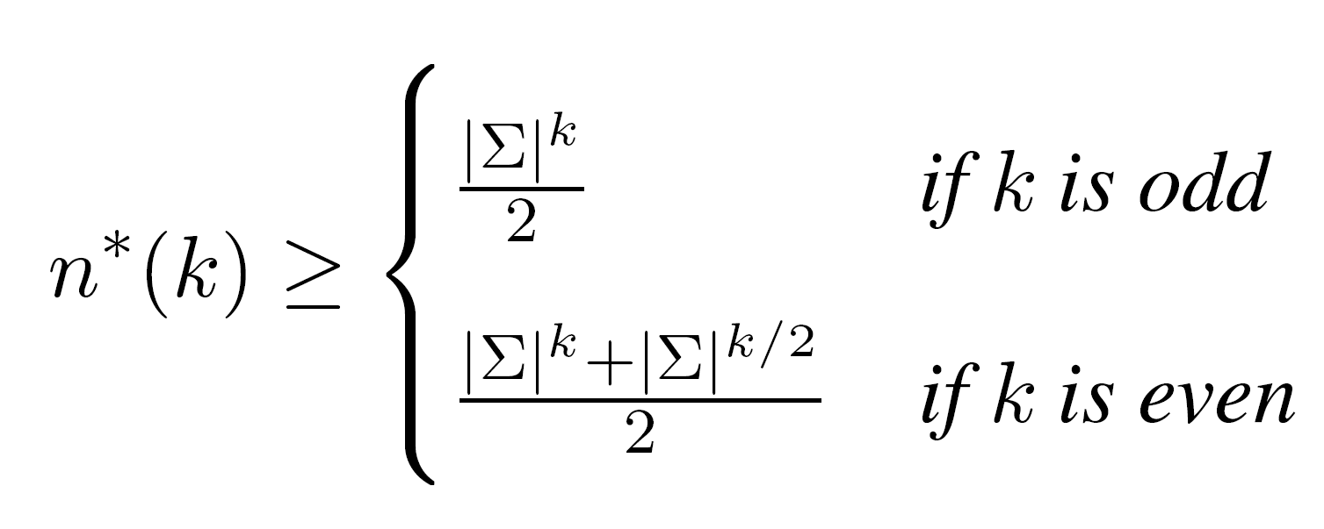
First, a simple lower bound
Derived due to k-mer counts:
For odd k, there are no palindromes.
For even k, there are palindromes, which must be represented in any sequence (e.g., ACGT).

Slide 15
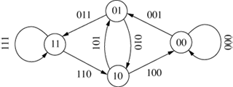
More definitions
Directed graph (digraph) G=(V,E).
Path, cycle.
Strongly connect component (SCC).
Eulerian digraph ⬄ strongly connected and for every vertex indergee equals outdegree.
De Bruijn graph of order k.
k=2, Σ={0,1}:
Euler tour in this graph is a de Bruijn sequence of order (k+1).

Slide 16
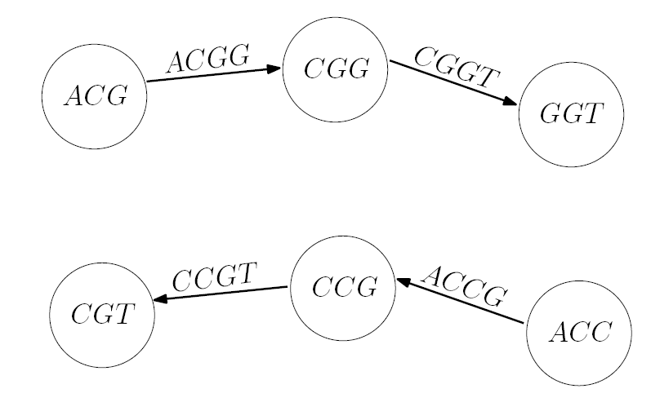
Forward and reverse path
A forward path is a path in the graph.
Its corresponding reverse path is a path, in which each edge in the forward path is replaced by its reverse complement and traversed in the opposite direction.

Slide 17
Theorem 1
An RCdB sequence of order k that achieves the lower bound exists ⬄ a forward and reverse paths with no repeating edges cover all edges of a de Bruijn graph of order (k-1).
→The sequence is a path in the graph, its reverse is another path. Due to their length and complete coverage, the paths have no repeating edges and cover all edges.
←The two paths are reverse complementary to each other. They cover all edges with no repeating edges, and thus represent an RCdB sequence of minimal length.

Slide 18
Reminder: finding an Eulerian cycle
Start with an empty stack and an empty circuit (Eulerian cycle). Choose an arbitrary vertex.
If current vertex has outgoing edges,
add the vertex to the stack, take any of its neighbors, remove the edge between that vertex and selected neighbor and set the neighbor as the current vertex.
Otherwise,
add it to circuit, remove the last vertex from the stack and set it as the current one.
3. Repeat step 2 until the current vertex has no more outgoing edges (neighbors) and the stack is empty.

Slide 19
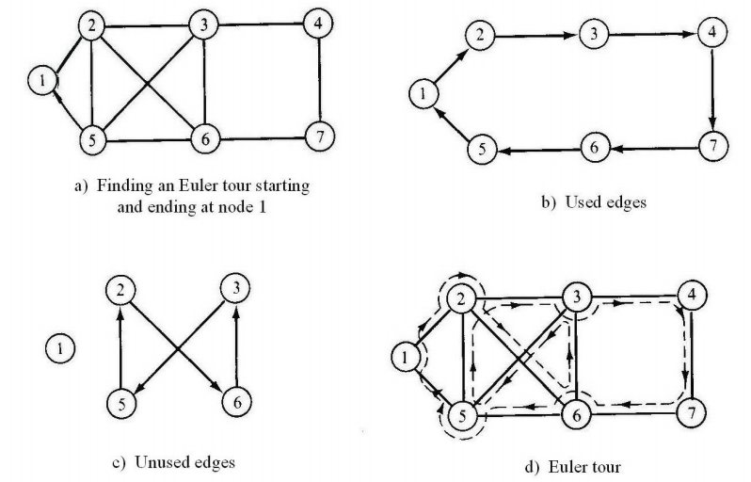
Finding an Eulerian cycle

Slide 20
Finding two RC Eulerian cycles
Works on a de Bruijn graph of order (k-1).
Start with an empty stack and an empty circuit (forward cycle). Choose an arbitrary vertex.
If current vertex has outgoing edges,
add the vertex to the stack, take any of its neighbors, remove the edge between that vertex and selected neighbor and the reverse complementary edge and set the neighbor as the current vertex.
Otherwise,
add it to circuit, remove the last vertex from the stack and set it as the current one.
3. Repeat step 2 until the current vertex has no more out-going edges (neighbors) and the stack is empty.

Slide 21
Algorithm’s proof
Lemma 1: When the forward path reaches a dead-end, so does the reverse. Both paths close a cycle.
Proof: Consider two cases:
Forward and reverse reach different vertices.
Forward and reverse path reach the same vertex (example: ACG and CGT).

Slide 22
Algorithm’s proof
Lemma 2: The forward cycles can be merged into one cycle.
Proof: Each cycle can be merged with its encompassing cycle. The initial cycle remains.

Slide 23
Algorithm’s proof
Lemma 3: The forward and reverse cycles cover all edges.
Proof: Algorithm continues till no outgoing edges are left. Thus, the two paths cover all edges of two or one connected components.
A de Bruijn graph is strongly connected, thus they cover all its edges.

Slide 24
OUR SOLUTION FOR EVEN K

Slide 25
The problem with even k
The algorithm can work with graphs that hold the following properties:
The graph is strongly connected.
Each vertex has indegree equal to its outdegree.
There is a perfect matching of the edges, where each pair represents a k-mer and its RC.
Even k’s are problematic due to palindromes!

Slide 26
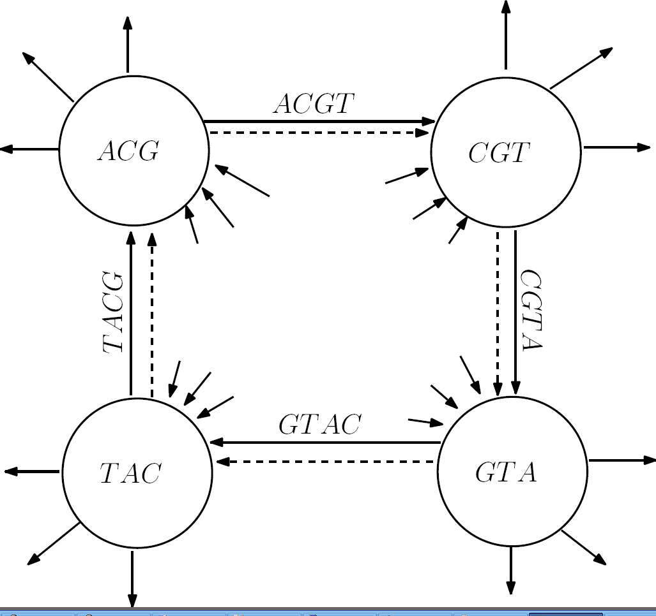
The solution
For each pair of palindrome edges, which are cyclic shifts of each other, add all cyclic shifts.
Example: ACGT, CGTA, GTAC, TACG.
Dashed edges are added edges.

Slide 27
The augmented de Bruijn graph
The addition of cycles preserves connectivity and degree equality.
Is the perfect matching preserved?
The added palindromes match the original palindromes in the graph.
The non-palindromic edges match each other.

Slide 28
Sequence length for even k
Using cycle augmentation, some k-mers are covered more than once.
Thus, the result does not reach the trivial lower bound.
The number of edges in the augmented graph is bounded by:
Sequence length is half of that number.

Slide 29
A more precise length
Periodic palindromes require less than k edges, e.g.: ATAT..AT and TATA..TA.
φ(k) = set of even integers that divide k.
Then, the number of added edges is:

Slide 30
RESULTS

Slide 31
Length results
10 | 8 | 6 | 4 | 2 | K
16777216 | 65536 | 4096 | 256 | 16 | Original
526840 | 33262 | 2140 | 142 | 10 | Alg.
1.990 | 1.97 | 1.91 | 1.8 | 1.6 | ratio
20 | 18 | 16 | 14 | 12 | K
1099511627776 | 68719476736 | 4294967296 | 268435456 | 16777216 | Original
549761054212 | 34360917820 | 2147745262 | 134275060 | 840080 | Alg.
1.99998 | 1.99993 | 1.9997 | 1.999 | 1.997 | ratio

Slide 32
Running times
On nova using current implementation.
Running time (seconds) | K
0.28 | 6
0.39 | 7
1.56 | 8
3.76 | 9
25.65 | 10
178.91 (3 minutes) | 11
445 (7.5 minutes) | 12
out of memory * | 13
* Will try on machines with greater memory.

Slide 33
BACK TO MINTSERIS AND EISEN PAPER

Slide 34
Was this problem already solved? (2)
“Every de Bruijn graph therefore contains within it two ‘reverse complementary’ sub-graphs.”
“Constructing the minimal superstring for odd-k graphs amounts to finding two ‘pseudo-Eulerian’ cycles, which are reverse complementary to each other.”
“Even-k graphs are further complicated by the fact that some nodes are reverse complements of each other (e.g. ACGT).”
“The number of nodes in a ‘pseudo-Eulerian’ cycle containing each k-mer or its reverse complement only once is equal to k/2 for odd k graphs and slightly more than k/2 for even k graphs.”

Slide 35
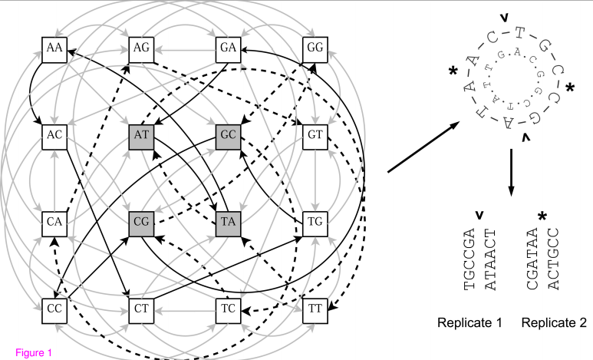
Was this problem already solved? (3)
Example from the paper for k=2:

Slide 36
Samantha’s code (1)
README file:
A DNA-Specific De Bruijn Set is an oligomer library that contains exactly one copy of exactly one representative for each k-mer and its reverse complement. For double-stranded DNA experiments, it can be useful for a library to have this property. For even values of k greater than 2, however, it is not possible to output a single sequence with this property, i.e., there is no perfect analog for a deBruijn sequence in the context where each k-mer and its reverse complement are restricted to a single representative. It is possible to compute a set of sequences with this property, for set sizes that are much smaller than the number of k-mers. This code was developed to do that.
https://thub.com/serisenfeld

Slide 37
Samantha’s code (2)
Looks for disjoint paths that cover all edges, depending on k and length of probes.
Works well for k=6 and length=15bp, but does not work for other parameters.
In this case, the theoretical lower bound is 2080bp, and we produce a sequence of 2140bp.

Slide 38
OPEN ISSUES

Slide 39
Solution optimality
The solution for odd k is optimal (achieves the lower bound).
But, is the solution for even k optimal?
Achieving the lower bound for a cycle sequence is impossible: a de Bruijn graph with parallel palindrome edges is not Eulerian.

Slide 40
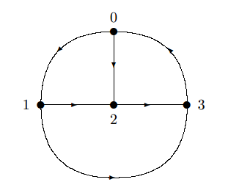
The Chinese postman problem
Find shortest cycle that traverses all edges in a weighted graph.
If Eulerian – Euler cycle. Otherwise, choose best pairing of odd vertices, add parallel paths, and find an Euler cycle.
Odd vertices are analog to vertices with unequal in and outdegrees and adding paths between them.

Slide 41
An intuition for the optimality proof
After adding the parallel palindrome edges, there are exactly |∑|^{k/2}/2 vertices with greater outdegrees, and |∑|^{k/2}/2 with greater indegrees.
The best pairing (i.e., shortest paths) is between palindromes that are cyclic shifts of each other (requires length of the period).
This also preserves the perfect matching of edges (s, RC(s)).
Example: ACGT to CGTA = ACG -> CGT -> GTA -> TAC
ACGT to TATA = ACG -> CGT -> GTT -> TTA -> TAT -> ATA

Slide 42
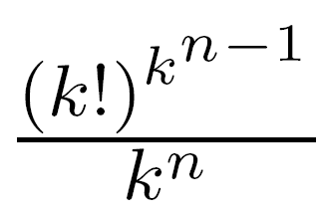
Other open problems
Is there an RCdB sequence with improved coverage of gapped k-mers?
What is the number of optimal RCdB sequences?
Probes design that minimizes the number of probes (no need for the cyclic constraint).

Slide 43
Conclusion
We solved the problem of generating a sequence that includes for each k-mer either itself or its reverse complement.
The solution is optimal for odd k, and achieves a saving of a factor of two.
The solution for even k is optimal (?), and the saving factor is almost two.

Slide 44
נושא לדיון מנהלי
מי מגיע ל-ISBMB?
שימוש ב-BIBTEX קבוצתי

